Slide 1
Test Techniques
Software Testing
ISTQB / ISEB Foundation Exam Practice
1 Principles
2 Lifecycle
3 Static testing
4 Test
techniques
5 Management
6 Tools
Chapter 4
Notes:
Principles: Nguyên tắc

Slide 2
CONTENTS
Categories of Test Techniques
Black-box Test Techniques
White-box Test Techniques
Experience-based Test Techniques

Slide 3
CONTENTS
Categories of Test Techniques
Black-box Test Techniques
White-box Test Techniques
Experience-based Test Techniques

Slide 4
Categories of Test Techniques
The purpose of a test technique is to identify test conditions, test cases, and test data.
Test conditions
Test Analysis
Test Design
Test cases
Test data
Test Implementation

Slide 5
Categories of Test Techniques
Static
Dynamic
Peer Reviews
Static Analysis
Specification-based
Walkthroughs
Technical Reviews
Equivalence
Partitioning
Experience-based
Inspection
Boundary
Value Analysis
Structure-based
Decision Table Testing
Error Guessing
Statement
State Transition Testing
Decision
Exploratory Testing
Use Case Testing

Slide 6
Categories of Test Techniques
Static
Dynamic
Peer Reviews
Static Analysis
Behavioural
Walkthroughs
Technical Reviews
Structural
Non-functional
Functional
etc.
Inspection
etc.
Usability
Equivalence
Partitioning
Control
Flow
Data
Flow
Performance
etc.
Boundary
Value Analysis
etc.
Statement
Symbolic
Execution
Cause-Effect Graphing
Branch/Decision
Arcs
Random
Definition
-Use
Branch Condition
LCSAJ
Branch Condition
Combination
State Transition

Slide 7

Three Types of Systematic Test Techniques
Static (non-execution)
  examination of documentation,
  source code listings, etc.
Behavioural (Black Box)
  based on behaviour /
  functionality of software
Structural (White Box)
  based on structure
  of software

Slide 8
Black box vs. White box
Black-box appropriate at all levels but dominates higher levels of testing
White-box used predominately at lower levels to compliment black box
Acceptance
System
Integration
Component

Slide 9
Dynamic Testing: 3 Sub-categories
 | Black-box | White-box | Experience-based
Test basis | SW reqs. Specifications. Use cases. User stories. | Architecture analysis. Detailed design. Internal structure. Code. | Knowledge of (Testers, Developers, Users).
Utilisation | Detect gaps b/w reqs. & implementation of reqs, deviations from reqs. | Determine paths through the software that either were taken or need to be taken. | Complement the other two types. Used when there is no / little / outdated specifications.
Coverage | Based on items tested on the test basis & technique applied to the test basis. | Based on items tested within a selected structure. | N/A

Slide 10
Question
Which one of the following options is categorized as a black-box test technique?
Techniques based on analysis of the architecture
Techniques checking that the test object is working according to the technical design
Techniques based on the expected use of the software
Techniques based on formal requirements

Slide 11
Question
If test cases are derived from looking at the code, what type of test design technique is being used?
Black-box
White-box
Specification-based
Behaviour-based

Slide 12
Question
Which of the following test techniques uses the requirements specifications as a test basis?
Structure-based
Black-box
White-box
Exploratory

Slide 13
CONTENTS
Categories of Test Techniques
Black-box Test Techniques
White-box Test Techniques
Experience-based Test Techniques
Equivalence Partitioning
Boundary value analysis
Decision table testing
State transition testing

Slide 14
Equivalence Partitioning (EP)
Can be applied at any level of testing & often a good technique to use first
Idea: divide (i.e., to partition) a set of test conditions into groups/sets where all elements of the set can be considered the same – the system should handle them equivalently.
Assumption: if one value works, all will work.
One from each partition better than all from one

Slide 15
Equivalence Partitioning (EP)
Example. In the SRS, we have FR08 about registration of a special training room in a training centre (opening 9am – 10pm). An SE course is currently always run from 5pm – 7:59pm everyday in that room. We are testing the booking function of that room.
If someone tries to book the room from 9am – 5pm, the room is available
If he/she tries to book the room from 5pm – 7:59pm, the room is occupied
If he/she tries to book the room from 9pm – 10pm, the room is available
1
2
3
9am
5pm
8pm
9pm

Slide 16
Equivalence Partitioning (EP)
4
1
2
3
5
9am
5pm
8pm
9pm
Invalid
Valid partitions
Invalid

Slide 17
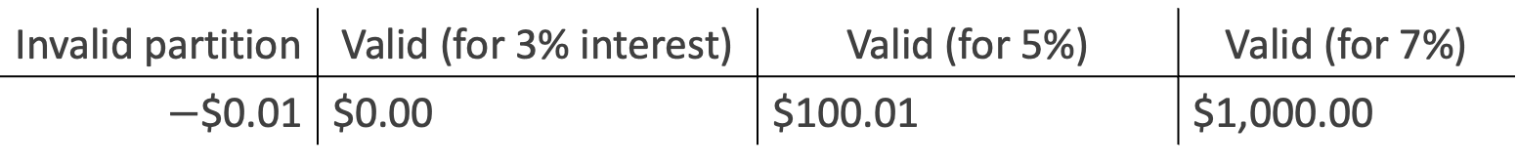
Equivalence Partitioning (EP)
Example: A savings account in a bank earns a different rate of interest depending on the balance in the account. To test the function that calculates the interest due, we can have different balance ranges:
[$0 … $100] – 3% interest rate
($100 … $1000) – 5% interest rate
[$1000 … ] – 7% interest rate
Invalid partition | Valid (for 3% interest) | Valid (for 5%) | Valid (for 7%)
$−$$0.01 | $0.00 | $100.01 | $1,000.00
$100.00
$999.99

Slide 18
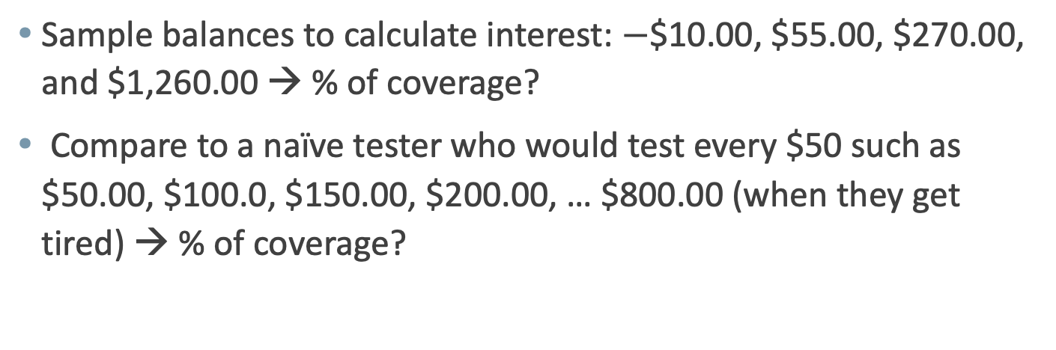
Equivalence Partitioning (EP)
Invalid partition | Valid (for 3% interest) | Valid (for 5%) | Valid (for 7%)
$−$$0.01 | $0.00 | $100.01 | $1,000.00
$100.00
$999.99
Sample balances to calculate interest: $−$$10.00, $55.00, $270.00, and $1,260.00 → % of coverage?
Compare to a naïve tester who would test every $50 such as $50.00, $100.0, $150.00, $200.00, … $800.00 (when they get tired) → % of coverage?

Slide 19
Equivalence Partitioning (EP)
Equivalence partitions is aka Equivalence classes
Partition that contains valid values is called a "valid equivalence partition", and invalid values is called an "invalid equivalence partition"
Each value must belong to one and only one equivalence partition
Any partition may be divided into sub partitions if required
Coverage is measured as the number of equivalence partitions tested by at least one value, divided by the total number of identified equivalence partitions
When invalid equivalence partitions are used, they should be tested individually. Whereas, values from valid partitions can be combined

Slide 20
Boundary value analysis (BVA)
  Faults tend to lurk near boundaries
  Good place to look for faults
  Test values on both sides of boundaries
invalid
valid
invalid
0
1
100
101

Slide 21
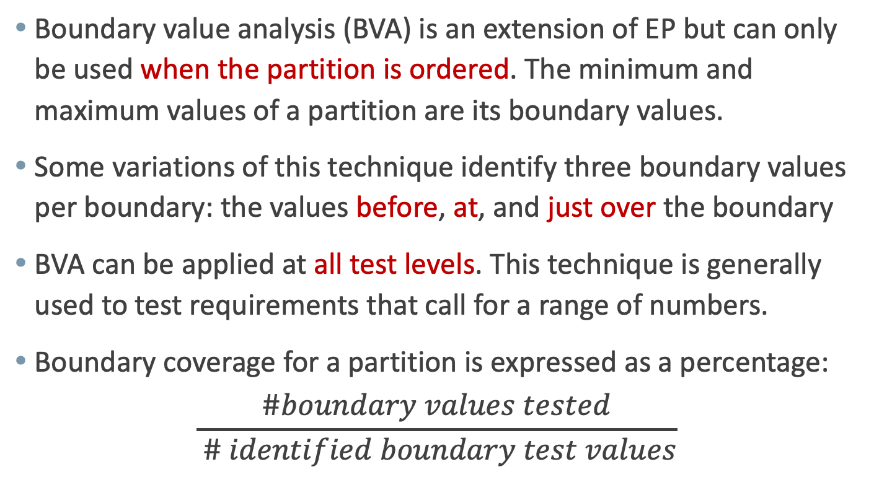
Boundary value analysis (BVA)
Boundary value analysis (BVA) is an extension of EP but can only be used when the partition is ordered. The minimum and maximum values of a partition are its boundary values.
Some variations of this technique identify three boundary values per boundary: the values before, at, and just over the boundary
BVA can be applied at all test levels. This technique is generally used to test requirements that call for a range of numbers.
Boundary coverage for a partition is expressed as a percentage:
$$\frac{\#boundary values tested}{ \# identified boundary test values}$$

Slide 22
Example: Loan Application
Customer Name
Account number
Loan amount requested
Term of loan
Monthly repayment
Term:
Repayment:
Interest rate:
Total paid back:
2-64 chars.
6 digits, 1st
non-zero
£500 to £9000
1 to 30 years
Minimum £10

Slide 23
Customer name
Number of characters:
1
2
64
65
invalid
valid
invalid
Valid characters:
A-Z
Any
other
-’
a-z
space
Conditions | Valid Partitions | Invalid Partitions | Valid Boundaries | Invalid Boundaries
Customer name | 2 to 64 chars | < 2 chars | 2 chars | 1 char
 |  | > 64 chars | 64 chars | 65 chars
 | valid chars | invalid chars |  | 0 char

Slide 24
Account number
valid: non-zero
first character:
invalid: zero
number of digits:
5
6
7
invalid
invalid
valid
Conditions | Valid Partitions | Invalid Partitions | Valid Boundaries | Invalid Boundaries
Account number | 6 digits | < 6 digits | 100000 | 99999
 |  | > 6 digits | 999999 | 1000000
 | 1st non-zero | 1st digit = 0 |  | _ (0 digit)
 |  | non-digit

Slide 25
Loan amount
499
500
9000
9001
invalid
valid
invalid
Conditions | Valid Partitions | Invalid Partitions | Valid Boundaries | Invalid Boundaries
Loan amount | 500 – 9000 | < 500 | 500 | 499
 |  | > 9000 | 9000 | 9001
 |  | 0
 |  | non-numeric
 |  | null

Slide 26
Condition Template
Condition | Valid Partitions | Tag | Invalid Partitions | Tag | Valid Boundaries | Tag | Invalid Boundaries | Tag
Customer name | 2 – 64 chars | VP1 | < 2 chars | IP1 | 2 chars | VB1 | 1 char | IB1
 | valid chars | VP2 | > 64 chars | IP2 | 64 chars | VB2 | 65 chars | IB2
 |  |  | invalid chars | IP3 |  |  | 0 char | IB3
Account number | 6 digits | VP3 | < 6 digits | IP4 | 100000 | VB3 | 99999 | IB4
 | 1st non-zero | VP4 | > 6 digits | IP5 | 999999 | VB4 | 1000000 | IB5
 |  |  | 1st digit = 0 | IP6 |  |  | _ (0 digit) | IB6
 |  |  | non-digit | IP7
Loan amount | 500 – 9000 | VP5 | < 500 | IP8 | 500 | VB5 | 499 | IB7
 |  |  | > 9000 | IP9 | 9000 | VB6 | 9001 | IB8
 |  |  | 0 | IP10
 |  |  | non-integer | IP11
 |  |  | null | IP12

Slide 27
Design Test Cases
Test Case | Description | Expected Outcome | New Tag Covered
1 | Name: John Smith Acc. No: 123456 Loan: 2500 Term: 3 years | Term: 3 years Repayment: 79.86 Interest rate: 10% Total paid: 2874.96 | V1, V2, V3, V4, V5,…
2 | Name: AB Acc. No: 100000 Loan: 500 Term: 1 year | Term: 1 year Repayment: 44.80 Interest rate: 7.5% Total paid: 537.60 | B1, B3, B5…

Slide 28
Why do both EP and BVA?
If you do boundaries only, you have covered all the partitions as well
  technically correct and may be OK if everything works correctly!
  if the test fails, is the whole partition wrong, or is a boundary in the wrong place - have to test mid-partition anyway
  testing only extremes may not give confidence for typical use scenarios (especially for users)
  boundaries may be harder (more costly) to set up

Slide 29
Test objectives?
Condition | Valid Partitions | Tag | Invalid Partitions | Tag | Valid Boundaries | Tag | Invalid Boundaries | Tag
For a thorough approach: VP, IP, VB, IB
Under time pressure, depends on your test objective
  minimal user-confidence: VP only?
  maximum fault finding: VB first (plus IB?)

Slide 30
Decision tables
Explore combinations of inputs, situations or events,
It is very easy to overlook specific combinations of input
Start by expressing the input conditions of interest so that they are either TRUE or FALSE
  record found
  file exists
  code valid
  policy expired
  account in credit
  due date > current date

Slide 31
4. Decision Table Testing
Decision table testing is black box test design technique to determine the test scenarios for complex business logic.
We can apply Equivalence Partitioning and Boundary Value Analysis techniques to only specific conditions or inputs.
Helps testers to search the effects of combinations of different inputs.

Slide 32
4. Decision Table Testing
Decision table components:
  Conditions:
    Inputs are interpreted as conditions (Dashes represent don’t care conditions)
    Condition entries binary values, they are called limited entry table.
    Condition entries have more than two values, they are called extended entry table.
  Actions
    Outputs are interpreted as actions
  Rules:
    The columns in a table are rules — they show which actions result from which conditions
    Every rule then becomes a test case
Notes:
(Don’t care condition are normally viewed as being false values which don’t require the value to define the output)

Slide 33
4. Decision Table Testing
A decision table has 4 portions:
  Condition stub
  Condition entry
  Action stubs
  Action entry
Notes:
(Don’t care condition are normally viewed as being false values which don’t require the value to define the output)

Slide 34
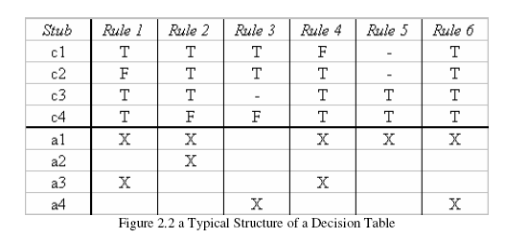
4. Decision Table Example
rules
conditions
values of conditions
actions taken
actions
Read a Decision Table by columns of rules :
R6 says when all conditions are T, then actions a1, a4 occur

Slide 35
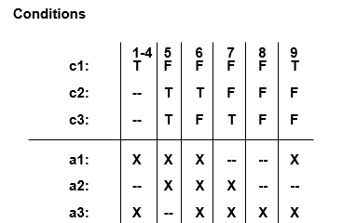
4. Decision Table
A Redundant Decision Table:
  Rule 9 is identical to Rule 4 (T, F, F)
  Since the action entries for rules 4 and 9 are identical, there is no ambiguity, just redundancy

Slide 36
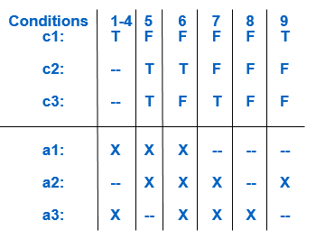
4. Decision Table
An Inconsistent Decision Table
  Rule 9 is identical to Rule 4 (T, F, F)
  Since the action entries for rules 4 and 9 are different, there is ambiguity =>the table is inconsistent, and the inconsistency implies non-determinism — can’t tell which rule to apply!

Slide 37
4. Decision Table
Procedure for Decision Table Testing:
  Determine conditions and actions.
  Develop the Decision Table, watching for
    Completeness
    Don’t care entries
    Redundant and inconsistent rules
  Each rule defines a test case

Slide 38
Example
A university computer system allows students an allocation of disc space depending on their projects.
If they have used all their allotted space, they are only allowed restricted access, i.e. to delete files, not to create them.
This is assuming they have logged on with a valid username and password.
What are the input and output conditions?

Slide 39
Example
Input Conditions: each entry in the table may be either ‘T’ for true, ‘F’ for false.

Slide 40
Example
Rationalise input combinations
  Some combinations may be impossible or not of interest
  Some combinations may be ‘equivalent’
  use a hyphen to denote “don’t care”

Slide 41
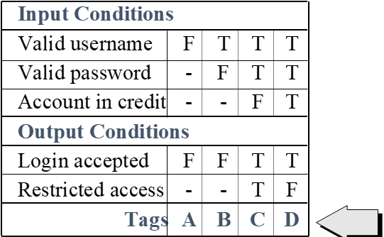
Example
Determine the expected output conditions for each combination of input conditions
Each column is at least one test case

Slide 42
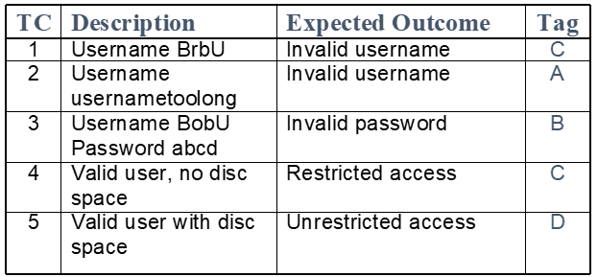
Example
Design test cases

Slide 43
Exercise
Create decision tables and some test cases for the following problems:
Ex1: Login function:
  User enters their user ID, then user enters their password
  If the user enters the incorrect password three times, the account is locked
  Display an error message if access to system is granted with valid account otherwise, allow user to login
Ex2: NextDate function
Ex3: Triangle problem

Slide 44
Example: Discount on SWT Course
A Software Testing course is created depending on this criteria:
If the trainee is a student, he/she will get 20% discount.
If the trainee is unemployed, he/she will get 20% discount.
The trainee cannot be both student & employed at the same time.
If the trainee is a student in (or a graduate from) computer science department, he/she will be directed to the advanced course group.
What are the input and output conditions?

Slide 45
List the Conditions & Actions
List the Conditions of all inputs in the first column of the table
List the Actions/Outcomes under the input conditions
Conditions
Student
Employed
CS major
Actions/Outcomes
Basics 0% dis.
Basics 20% dis.
Adv. 0% dis.
Adv. 20% dis.

Slide 46
Identify Input Combinations
Add columns to the table for each unique combination of input conditions.
Each entry in the table may be either 'T' for true, 'F' for false.
Conditions | 1 | 2 | 3 | 4 | 5 | 6 | 7 | 8
Student | T | T | T | T | F | F | F | F
Employed | T | T | F | F | T | T | F | F
CS major | T | F | T | F | T | F | T | F
Actions/Outcomes
Basics 0% dis.
Basics 20% dis.
Adv. 0% dis.
Adv. 20% dis.

Slide 47
Rationalise Input Combinations
Some combinations may be impossible or not of interest
Some combinations may be 'equivalent'
Use a hyphen to denote "don't care"

Slide 48
Rationalise Input Combinations
Conditions | 1 | 2 | 3 | 4 | 5 | 6 | 7 | 8
Student | T | T | T | T | F | F | F | F
Employed | T | T | F | F | T | T | F | F
CS major | T | F | T | F | T | F | T | F
Actions/Outcomes
Basics 0% dis.
Basics 20% dis.
Adv. 0% dis.
Adv. 20% dis.

Slide 49

Reduce # of Test Cases
Conditions | 1 | 2 | 3 | 4 | 5 | 6 | 7 | 8
Student | T | T | T | T | F | F | F | F
Employed | T | T | F | F | T | T | F | F
CS major | T | F | T | F | T | F | T | F
Actions/Outcomes
Basics 0% dis.
Basics 20% dis.
Adv. 0% dis.
Adv. 20% dis.
$$−$$

Slide 50
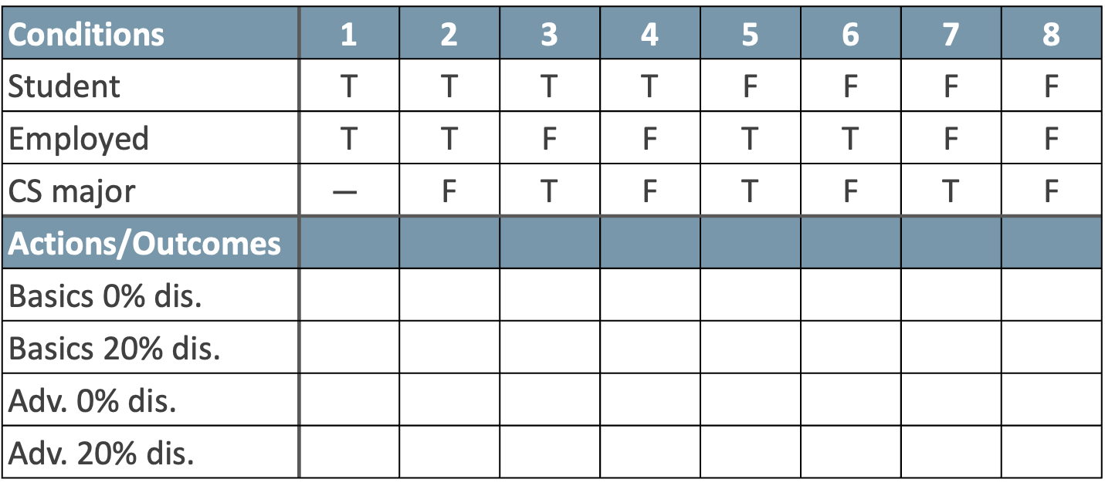

Reduce # of Test Cases
Conditions | 1 | 2 | 3 | 4 | 5 | 6 | 7 | 8
Student | T | T | T | T | F | F | F | F
Employed | T | T | F | F | T | T | F | F
CS major | $$−$$ | F | T | F | T | F | T | F
Actions/Outcomes
Basics 0% dis.
Basics 20% dis.
Adv. 0% dis.
Adv. 20% dis.
$$−$$

Slide 51
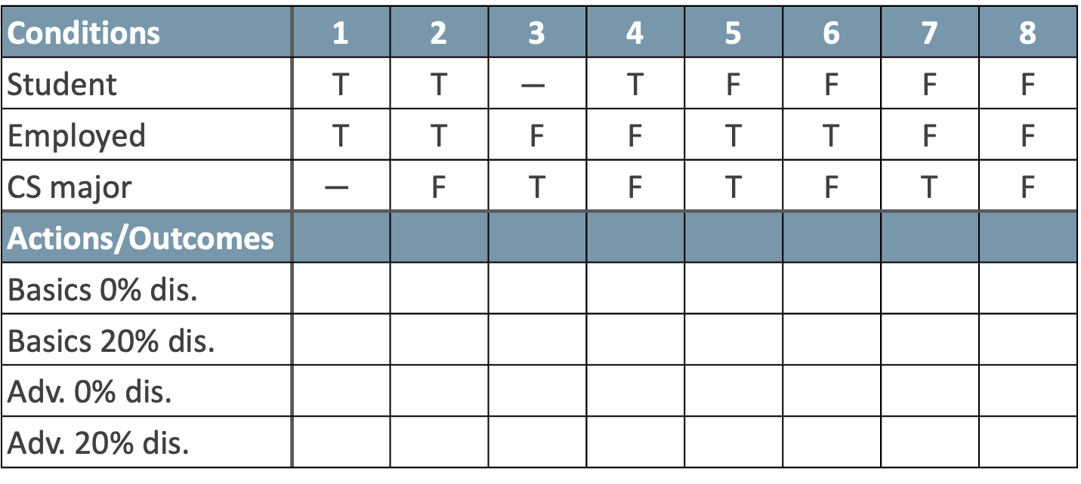

Reduce # of Test Cases
Conditions | 1 | 2 | 3 | 4 | 5 | 6 | 7 | 8
Student | T | T | $$−$$ | T | F | F | F | F
Employed | T | T | F | F | T | T | F | F
CS major | $$−$$ | F | T | F | T | F | T | F
Actions/Outcomes
Basics 0% dis.
Basics 20% dis.
Adv. 0% dis.
Adv. 20% dis.
$$−$$

Slide 52
Reduce # of Test Cases
Conditions | 1 | 3 | 4 | 5 | 6 | 2 | 7 | 8
Student | T | T | T | F | F | T | F | F
Employed | T | F | F | T | T | T | F | F
CS major | T | T | F | T | F | F | T | F
Actions/Outcomes
Basics 0% dis.
Basics 20% dis.
Adv. 0% dis.
Adv. 20% dis.

Slide 53
Rationalising outputs
if outputs or effects are mutually exclusive, I.e. T occurs in only one place in each column, we can combine them
for example:
X T F F
is equivalent to:
Y F T F
Z F F T
Output X Y Z

Slide 54
Rationalising dangers
Rationalising is based on assumptions
Assumptions may be wrong!
Assumptions should be stated
Assumptions may change over time
Be aware of the dangers
  Filling in the full table may find errors which will be missed if you rationalise
  It is possible to rationalise too far

Slide 55
Extending decision tables
Entries can be more than just ‘true’ or ‘false’
  completing table needs to be done carefully
  rationalising becomes more important
E.g.

Slide 56
Decision Tables in relation to EP and BVA
Input value
Output value
FALSE
TRUE

Slide 57
State Transition Testing
A state transition diagram shows a limited (finite) number of different states, and the transitions from one state to another a determined by the rules of the 'machine'.
A transition is initiated by an event (e.g., user input of a value into a field). The event results in a transition.
The state change may result in the software taking an action (e.g., outputting a calculation or error message).
A state transition table shows all valid transitions and potentially invalid transitions between states.
State transition diagrams normally show only the valid transitions and exclude the invalid transitions.

Slide 58
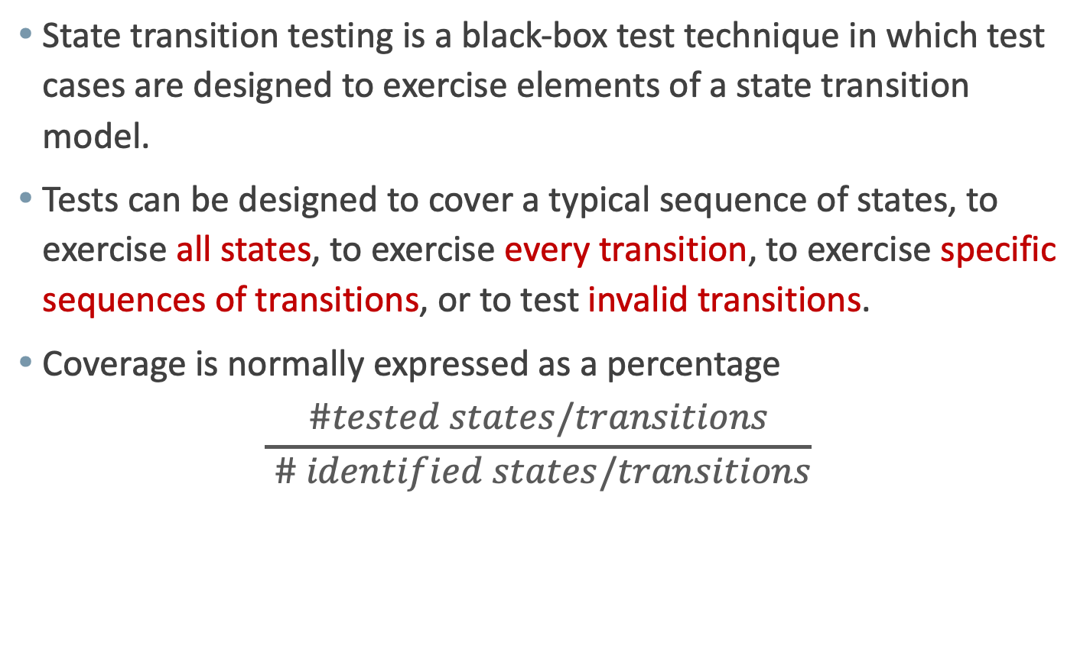
State Transition Testing
State transition testing is a black-box test technique in which test cases are designed to exercise elements of a state transition model.
Tests can be designed to cover a typical sequence of states, to exercise all states, to exercise every transition, to exercise specific sequences of transitions, or to test invalid transitions.
Coverage is normally expressed as a percentage
$$\frac{\#tested states/transitions}{ \# identified states/transitions}$$

Slide 59
State Transition Testing
Start
Eat fart
insert card
enter invalid …
enter invalid PIN
enter PIN
enter invalid …
Wait for PIN
1st try
2nd try
3rd try
enter valid …
enter valid PIN
enter valid …
Account access
# test required to cover all states?

Slide 60
State Transition Testing
Start
Eat fart
insert card
enter invalid …
enter invalid PIN
enter PIN
enter invalid …
Wait for PIN
1st try
2nd try
3rd try
enter valid …
enter valid PIN
enter valid …
Account access
# test required to cover all states?
2

Slide 61
State Transition Testing
Start
Eat card
insert card
enter invalid …
enter invalid PIN
enter PIN
enter invalid …
Wait for PIN
1st try
2nd try
3rd try
enter valid …
enter valid PIN
enter valid …
Account access
# test required to cover all states?
2
# test required to cover all transitions?

Slide 62
State Transition Testing
Start
Eat fart
insert card
enter invalid …
enter invalid PIN
enter PIN
enter invalid …
Wait for PIN
1st try
2nd try
3rd try
enter valid …
enter valid PIN
enter valid …
Account access
# test required to cover all states?
2
# test required to cover all transitions?

Slide 63
State Transition Testing
Start
Eat fart
insert card
enter invalid …
enter invalid PIN
enter PIN
enter invalid …
Wait for PIN
1st try
2nd try
3rd try
enter valid …
enter valid PIN
enter valid …
Account access
# test required to cover all states?
2
# test required to cover all transitions?

Slide 64
State Transition Testing
Start
Eat fart
insert card
enter invalid …
enter invalid PIN
enter PIN
enter invalid …
Wait for PIN
1st try
2nd try
3rd try
enter valid …
enter valid PIN
enter valid …
Account access
# test required to cover all states?
2
# test required to cover all transitions?
4

Slide 65
State Transition Testing
invalid transition
Events
 | Insert card | Valid PIN | Invalid PIN
S1) Start state
S2) Wait for PIN
S3) 1st try invalid
S4) 2nd try invalid
S5) 3rd try invalid
S6) Access account
S7) Eat card
?
–
S2
?
–
–
?
?
?
S6
S3
–
?
?
S6
S4
–
?
States
S6
S5
–
–
?
S7
–
– / ?
– / ?
S1 (new card)
–
–
?

Slide 66
Exercise
A website shopping basket starts out empty. As purchases are selected, they are added to the shopping basket. Items can also be removed from the basket.
When the customer decides to check out, a summary of the items and the total cost are shown. Customer states if the information is ok
If the contents and the price are OK, then the customer will be redirected to the payment system. Otherwise, you go back to shopping
  Produce a state diagram
  Define a state table which to cover all transitions

Slide 67
Question
You are testing an unattended gasoline pump that only accept credit cards. Once the card is validated, the pump nozzle placed into the tank, and the desired grade selected, the customer enters the desired amount of fuel in gallons with the keypad. The keypad only allows the entry of digits. Fuel is sold in tenths (0.1) of a gallon, up to 50.0 gallons.
Which of the following is a minimum set of desired amounts that covers the equivalence partitions for this input?
0.0, 10.0, 60.0
0.0, 0.1, 50.0
0.0, 0.1, 50.0, 70.0
-0.1, 0.0, 0.1, 49.9, 50.0, 50.1

Slide 68
Question
You are testing a machine that scores exam papers and assign grades. Based on the score achieved, the grades are as follows:
1 – 49 = F; 50 – 59 = D-; 60 – 69 = D;
70 – 79 = C; 80 – 89 = B; 90 – 100 = A
If you apply EP, how many test cases will you need to achieve minimum test coverage?
6
8
10
12

Slide 69
Question
You are testing a machine that scores exam papers and assign grades. Based on the score achieved, the grades are as follows:
1 – 49 = F; 50 – 59 = D-; 60 – 69 = D;
70 – 79 = C; 80 – 89 = B; 90 – 100 = A
If you apply BVA, how many test cases will you need to achieve minimum test coverage?
8
10
12
14

Slide 70
Question
You are testing a scale system that determines shipping rates for a web-based auto part distributor. Identify how many equivalence classes are necessary for the following range. Weights are rounded to the nearest pound.
8
6
5
4
Weight | 1 … 10 lbs | 11 … 25 lbs | 26 … 50 lbs | 51 lbs & up
Shipping cost | $5.00 | $7.50 | $12.00 | $17.00

Slide 71
Question
Which of the following statements are true for the EP test technique?
Divides possible inputs into classes that have the same behaviour
Uses both valid and invalid partitions
Makes use only of valid partitions
Must include at least two values from every equivalence partition
Can be used only for testing systems that have a GUI
A, B & E
A, C & D
A & E
A & B

Slide 72
Question
An employee’s bonus is to be calculated. It cannot be negative, but it can be calculated down to zero. The bonus is based on the length of employment. An employee can be employed for less than or equal to 2 years, more than 2 years but less than 5 years, 5 to 10 years, or longer than 10 years.
What is the minimum number of test cases required to cover all valid equivalence partitions for calculating the bonus?
3
5
2
4

Slide 73
Question
In a system designed to work out the tax to be paid, an employee has $4,000 of salary tax free. The next $1,500 is taxed at 10%. The next $28,000 is taxed at 22%. Any further amount is taxed at 40$. Which of these groups of numbers would fall into the same equivalence class?
4,800 – 14,000 – 28,000
5,200 – 5,500 – 28,000
28,001 – 32,000 – 35,000
5,800 – 28,000 – 32,000
-1
0
4,000
5,500
33,500
0%
10%
22%
40%

Slide 74
Question
A smart home app measures the average temperature in the house over the previous week & provide feedback to the occupants on their environmental friendliness based on this temperature. The feedback is as such:
Using BVA (only min- and max- value), which of the following sets of test inputs provides the highest level of boundary coverage?
0ºC, 15ºC, 25ºC, 28ºC, 29ºC
13ºC, 19ºC, 24ºC, 30ºC, 50ºC
14ºC, 20ºC, 24ºC, 30ºC, 31ºC
18ºC, 19ºC, 23ºC, 24ºC, 29ºC, 30ºC
Up to 14ºC – Freezing 15ºC to 19ºC – Cold 20ºC to 24ºC – Cool | 25ºC to 30ºC – Open the window Above 30ºC – Turn the AC on

Slide 75
Question
An e-commerce system sells cooking supplies in bulk. The units in which the items are sold are either grams (expensive items) or kilograms (cheap items). Regardless of the units, the smallest valid order amount is 0.5 units and the largest valid order amount is 25.0 units. The precision of the units field is 0.1 units.
Which of the following is a set of input values that cover the boundary values with 2-point boundary values for this field?
0.3, 10.0, 28.0
0.4, 0.5, 0.6, 14.9, 25.0, 25.1
0.4, 0.5, 25.0, 25.1
0.5, 0.6, 24.9, 25.0

Slide 76
Question
You’re testing a scale system that determines shipping rates for a regional web-based auto parts distributor. Due to regulations, shipments cannot exceed 100 lbs. You want to include boundary value analysis as part of your black-box test design. How many test will you need to execute to achieve 100% BVA?
4
8
10
12
Weight | 1 … 10 lbs | 11 … 25 lbs | 26 … 50 lbs | 51 … 100 lbs
Shipping cost | $5.00 | $7.50 | $12.00 | $17.00

Slide 77
Question
Consider the following decision table for the portion of an online airline reservation system that allows frequent flyers to redeem points for reward travel:
There are 2 equivalence partitions for the condition where Account/Password OK is not True (i.e., False): (1) account is invalid, and (2) account is valid but password is invalid. There is only 1 equivalence partition for the condition where Account/Password OK is True: the account & password are valid. If you want to design tests to cover the equivalence partitions for Account/Password OK and also for this portion of the decision table, what is the minimum number of tests required?
Condition | 1 | 2 | 3
Account/password OK | F | T | T
Sufficient points | - | F | T
Action
Show flight history | F | T | T
Allow reward travel | F | F | T
4

Slide 78
CONTENTS
Categories of Test Techniques
Black-box Test Techniques
White-box Test Techniques
Experience-based Test Techniques
Statement coverage
Decision coverage

Slide 79
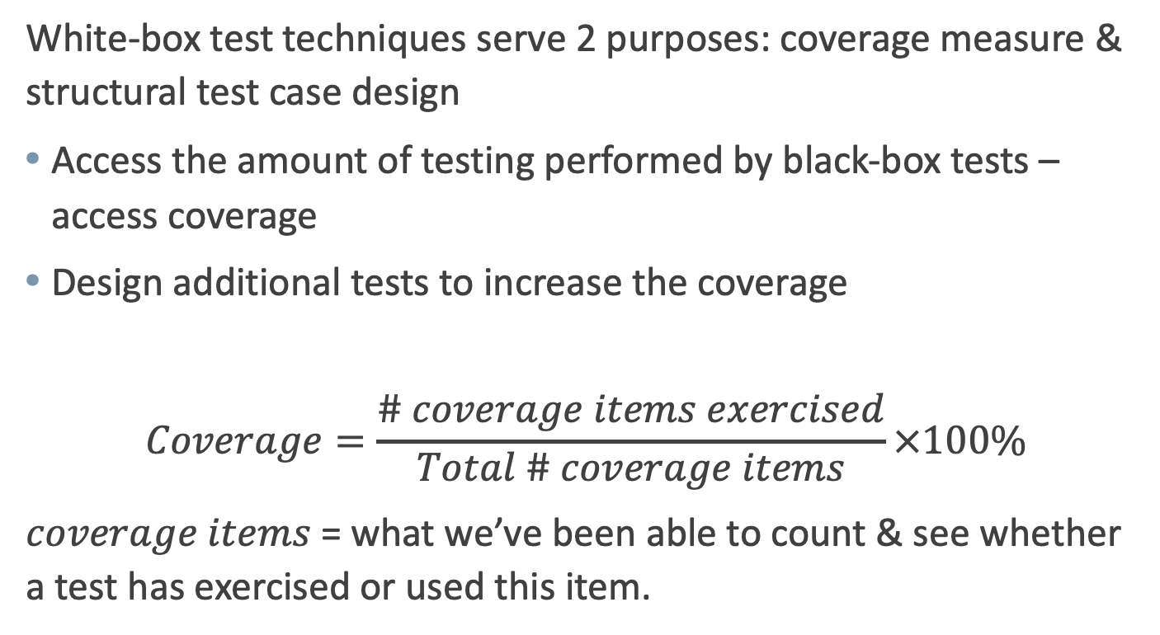
White-box Test Techniques
White-box test techniques serve 2 purposes: coverage measure & structural test case design
Access the amount of testing performed by black-box tests – access coverage
Design additional tests to increase the coverage
$$Coverage=\frac{\# coverage items exercised}{Total \# coverage items}×100\%$$
$coverage items$= what we’ve been able to count & see whether a test has exercised or used this item.

Slide 80
Using Structural Coverage
Spec
Enough
tests?
Software
Tests
Results OK?
What's
covered?
More tests
Coverage OK?
More tests
More tests
More tests
More tests
More tests
More tests
More tests
Stronger structural techniques (different structural elements)
Increasing coverage

Slide 81
The test coverage trap
100% coverage does
not mean 100% tested!
Function exercised,
insufficient structure
Coverage is only one aspect of thoroughness
better testing
Functional testedness
Structure exercised,
insufficient function
% Statement % Decision % Condition
Combination
Structural testedness

Slide 82
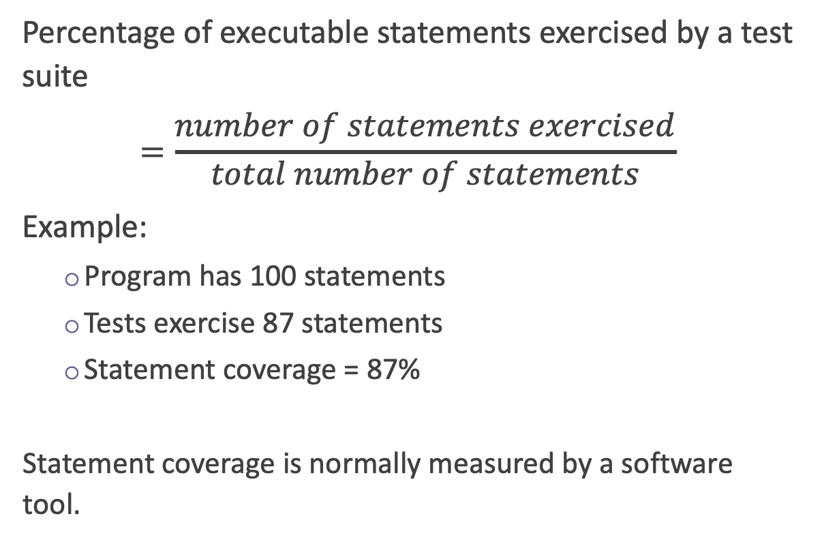
Statement coverage
Percentage of executable statements exercised by a test suite
$$=\frac{number of statements exercised}{total number of statements}$$
Example:
  Program has 100 statements
  Tests exercise 87 statements
  Statement coverage = 87%
  Statement coverage is normally measured by a software tool.
?
Typical ad hoc testing achieves 60 – 75%

Slide 83
Example 1
Test
case
Input
Expected
output
1
2
3
4
5
read(a)
IF a > 6 THEN
b = a
ENDIF
print b
1
7
7
As all 5 statements are ‘covered’ by
this test case, we have achieved
100% statement coverage
Statement
numbers

Slide 84
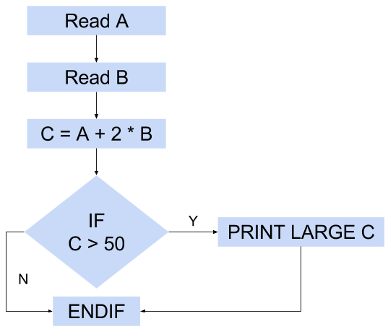
Example 2
1
2
3
4
5
6
READ A
READ B
C = A + 2 * B
IF C>50 THEN
PRINT ‘LARGE C’
ENDIF
project title
Test cases:
Test 1_1: A= 2, B = 3
Test 1_2: A= 0, B = 25
Test 1_3: A= 47, B = 1
Test 1_4: A = 20, B = 25 (C=70, 100% statement coverage)
83% statement coverage
    => only one test case needed to achieve 100% statement coverage

Slide 85
Decision coverage
Also known and Branch Coverage and C2 Coverage.
This technique is used to make sure that all branch of every control structure (if, while, etc.) is executed at least once.
It covers both the true and false conditions unlikely the statement coverage.
Disadvantage: Does not cover all conditions in logical operators.
100% decision coverage guarantees 100% statement coverage, but 100% statement coverage does not guarantees 100% decision coverage

Slide 86
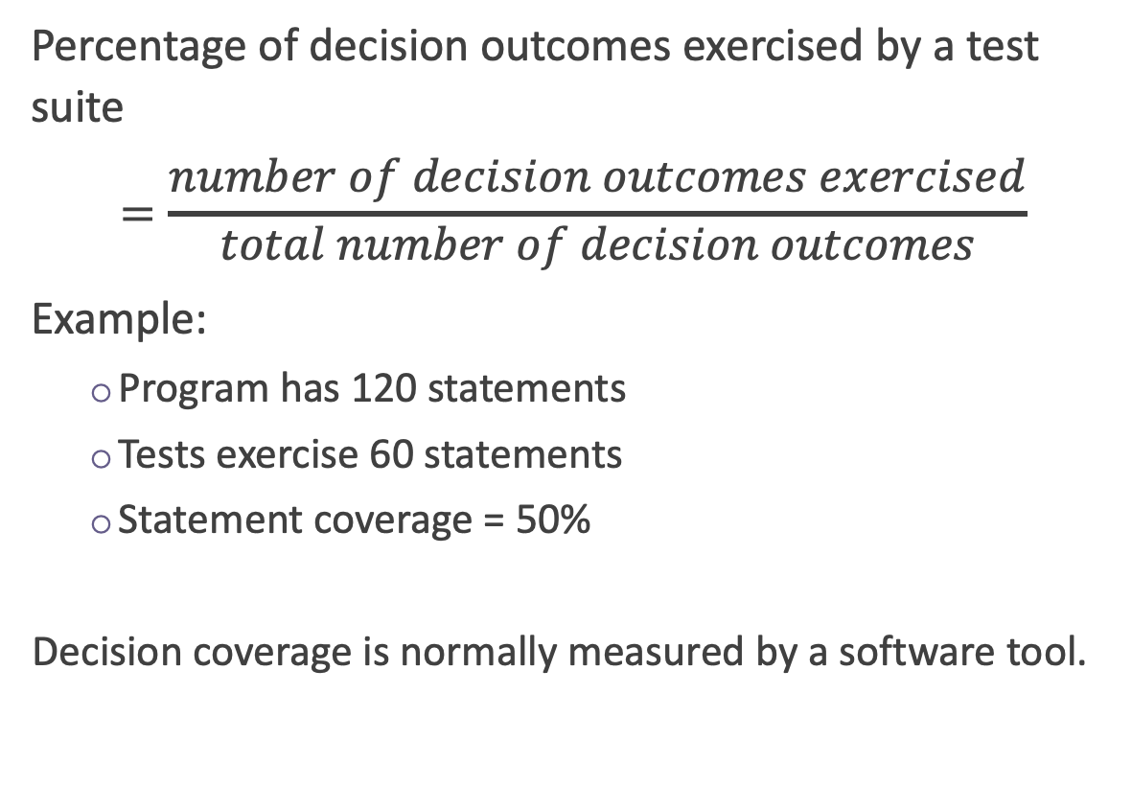
Decision coverage (Branch coverage)
Percentage of decision outcomes exercised by a test suite
$$=\frac{number of decision outcomes exercised}{total number of decision outcomes}$$
Example:
  Program has 120 statements
  Tests exercise 60 statements
  Statement coverage = 50%
  Decision coverage is normally measured by a software tool.
?
False
True
Typical ad hoc testing achieves 40 – 60%

Slide 87
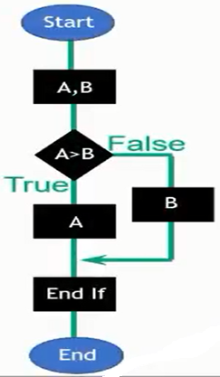
Example 1
  READ A
  READ B
  IF A>B THEN
  PRINT ‘A is bigger’
  ELSE
  PRINT ‘B is bigger’
  ENDIF
TEST CASES
Test 1_1: A = 20, B = 15
Test 1_2: A = 10, B = 15
This now covers both of the decision outcomes:
True (with Test 1_1) and False (with Test 1_2).
Decision coverage = 2
Notes:
Tip: count of if +1

Slide 88
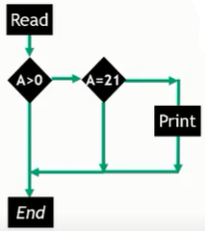
Example 2
  READ A
  IF A>0 THEN
  IF A = 21 THEN
  PRINT ‘A = 21’
  ENDIF
  ENDIF
What is the minimum number test cases required for 100% decision coverage?
Decision coverage= ?
Notes:
Decision coverage = 3

Slide 89
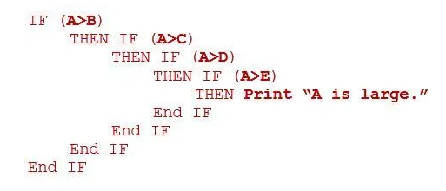
Example 3
Consider the following Pseudo code:
How many minimum test cases are required to cover 100% statement coverage and decision coverage?
A. 2 for Statement, 5 For Decision
B. 1 for Statement, 2 for Decision
C. 1 for Statement, 5 for Decision
D. 5 for Statement, 1 for Decision
Notes:
C

Slide 90
Paths through code
1
2
3
4
1
2
1
2
2
3
1
?
?
?
?
?
?

Slide 91
Paths through code with loops
1
2
3
4
5
6
7
8 ….
for as many times as it
is possible to go round
the loop (this can be
unlimited, i.e. infinite)
?

Slide 92
Cyclomatic Complexity
Cyclomatic Complexity (CC) of the flow chart indicates the number of independent paths of the program.
CC gives an indication of the minimum number of test cases required
It is said to be a measure of the logical complexity of a program
Notes:
1-10Structured and well written code
High Testability
Cost and Effort is less10-20Complex Code
Medium Testability
Cost and effort is Medium20-40Very complex Code
Low Testability
Cost and Effort are high>40Not at all testable
Very high Cost and Effort

Slide 93
Cyclomatic Complexity
Cyclomatic complexity (CC) can be calculated using 3 different formulae:
Based on edges and nodes:
CC = E − N + 2P,
where:
E = the number of edges of the graph
N = the number of nodes of the graph
P = the number of connected components
Number of closed regions (including the surrounding rectangle) +1
Number of binary predicate + 1.

Slide 94
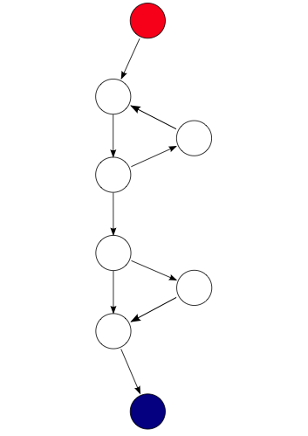
Example 1
CC = 3:
9 (edges) – 8 (nodes) + 2*1 (connected component) = 3
2 (closed regions) +1 = 3
2 (Conditional Nodes) + 1 = 3

Slide 95
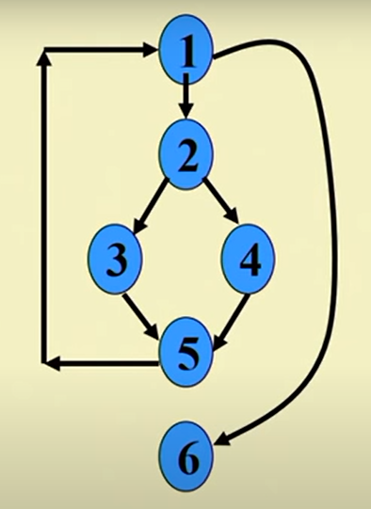
Example 2
Compute CC?
Notes:
Number of independent paths: 3
1,6 test case (x=1, y=1)
1,2,3,5,1,6 test case(x=1, y=2)
1,2,4,5,1,6 test case(x=2, y=1)

Slide 96
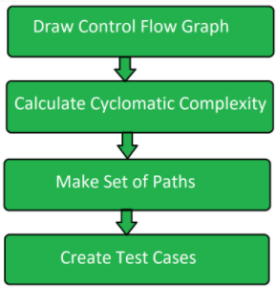
5. Basic Path Testing
The basic steps involved in basis path testing include:

Slide 97
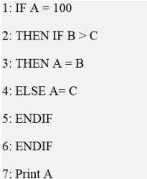
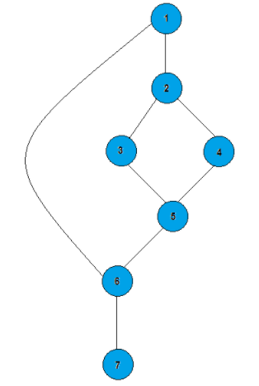
Basis Path Testing: Example
Step 1: Draw a control flow graph

Slide 98
Basis Path Testing: Example
Step 2: Calculate cyclomatic complexity (CC)
CC = edges - nodes + 2p = 8-7+2*1=3
CC = number of closed regions+1 = 2+1 =3
CC = number of binary predicate + 1 = 2+1 =3

Slide 99
Basis Path Testing: Example
Step 3: Make set of basis paths
The cyclomatic complexity tells us the number of paths to evaluate for basis path testing.
We have 3 paths and our basis set of paths is:
Path 1: 1, 2, 3, 5, 6, 7.
Path 2: 1, 2, 4, 5, 6, 7.
Path 3: 1, 6, 7.

Slide 100
Basis Path Testing: Example
Step 4: Create test cases
After determining the basis of path, we will generate the test case for each path.
Usually we need at least 3 test cases to cover 3 paths, but in this example Path 3 is already covered by Path 1 and 2 so we just write 2 test cases only.
Test case | From Path | A | B | C | Expected result
1 | P1 | 100 | 120 | 50 | A=120
2 | P2 | 100 | 20 | 50 | A=20
3 | P3 | 90 | - | - | A=90

Slide 101
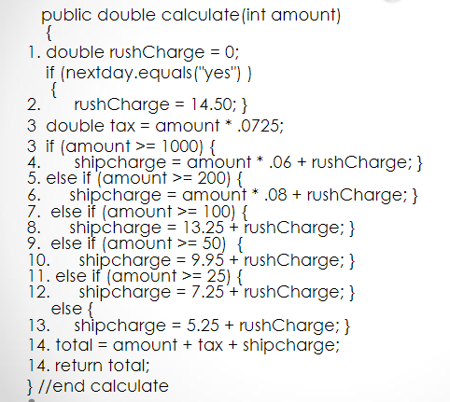
Exercise 1
Basis path testing for the segment code:

Slide 102
Exercise 2
Basis path testing for the segment code:
internal static int GetMaxDay(int month, int day, int year)
{
int maxDay = 0;
if (!IsInvalidDate(month, day, year)) {
if (IsThirtyOneDayMonth(month)) {
maxDay = 31;
}
else if (IsThirtyDayMonth(month)) {
maxDay = 30;
}
else {
maxDay = 28;
if (IsLeapYear(year)) {
maxDay = 29;
}
}
return maxDay;
}

Slide 103
Example 1
Wait for card to be inserted
IF card is a valid card THEN
display “Enter PIN number”
IF PIN is valid THEN
select transaction
ELSE (otherwise)
display “PIN invalid”
ELSE (otherwise)
reject card
End

Slide 104
Example 1
Wait
Valid
card?
Wait for card to be inserted
IF card is a valid card THEN
display "Enter PIN number"
IF PIN is valid THEN
select transaction
ELSE (otherwise)
display “PIN invalid”
ELSE (otherwise)
reject card
End
Yes
Display
"Enter..
No
Valid
PIN?
Yes
Select
trans...
Reject
card
No
Display
"PIN in..
End

Slide 105
Example 2
Read
Read A
IF A > 0 THEN
IF A = 21 THEN
Print “Key”
ENDIF
ENDIF
Yes
A>0
A=21
Yes
Print
No
No
3
Cyclomatic complexity: _____
Minimum tests to achieve:
  Statement coverage: ______
  Branch coverage: _____
End
1
3

Slide 106
Example 3
Read
Read A
Read B
IF A > 0 THEN
IF B = 0 THEN
Print "No values"
ELSE
Print B
IF A > 21 THEN
Print A
ENDIF
ENDIF
ENDIF
A>0
B=0
No
Print
No
Yes
Print
A>21
Print
Yes
No
No
End
4
Cyclomatic complexity: _____
Minimum tests to achieve:
  Statement coverage: ______
  Branch coverage: _____
2
4

Slide 107
Example 4
A<0
Yes
Read
Print
No
Read A
Read B
IF A < 0 THEN
Print “A negative”
ELSE
Print “A positive”
ENDIF
IF B < 0 THEN
Print “B negative”
ELSE
Print “B positive”
ENDIF
Note: there
are 4 paths
Print
B<0
Yes
Print
No
Print
End
3
  Cyclomatic complexity: _____
  Minimum tests to achieve:
    Statement coverage: ______
    Branch coverage: _____
2
2

Slide 108
Example 5
A<0
Yes
Read
Print
No
Read A
Read B
IF A < 0 THEN
Print “A negative”
ENDIF
IF B < 0 THEN
Print “B negative”
ENDIF
B<0
Yes
Print
No
End
3
  Cyclomatic complexity: _____
  Minimum tests to achieve:
    Statement coverage: ______
    Branch coverage: _____
1
2

Slide 109
Example 6
A<0
Yes
Read
Print
No
Read A
IF A < 0 THEN
Print “A negative”
ENDIF
IF A > 0 THEN
Print “A positive”
ENDIF
A>0
Yes
Print
No
End
3
  Cyclomatic complexity: _____
  Minimum tests to achieve:
    Statement coverage: ______
    Branch coverage: _____
2
2

Slide 110
CONTENTS
Categories of Test Techniques
Black-box Test Techniques
White-box Test Techniques
Experience-based Test Techniques

Slide 111

Experience-based techniques
Test cases are derived from the tester’s skill and intuition, and their experience with similar applications and technologies.
Can be helpful in identifying tests that were not easily identified by other more systematic techniques.
Depending on tester’s approach and experience, these techniques may achieve widely varying degrees of coverage and effectiveness.
Coverage can be difficult to assess and may be unmeasurable with these techniques.

Slide 112

Error Guessing
A methodical approach to the error guessing technique is to create a list of possible mistakes, defects & failures → design tests that will expose those failures & the defects that caused them.
These mistake, defect, failure lists can be built based on experience, defect and failure data, or from common knowledge about why software fails.

Slide 113

Exploratory Testing
A hands-on approach in which testers are involved in minimum planning and maximum test execution.
Test design & execution activities are performed in parallel, often without formal documentation.
Informal tests are designed, executed, logged, and evaluated dynamically during test execution.
The test results are used to learn more about the component or system, and to create tests for the areas that may need more testing.

Slide 114
Exploratory Testing
Exploratory testing is sometimes conducted using session-based testing to structure the activity.
In session-based testing, exploratory testing is conducted within a defined time-box, and the tester uses a test charter containing test objectives to guide the testing.
Exploratory testing is most useful when there are few or inadequate specifications or significant time pressure on testing.

Slide 115

Checklist-based Testing
Experienced tester uses a checklist to design, implement and execute tests based on the items or test conditions in the list.
As part of analysis, testers create a new checklist or expand an existing checklist, but testers may also use an existing checklist without modification.
Such checklists can be built based on:
  experience of the tester
  knowledge about what is important for the user
  understanding of why and how software fails

Slide 116
Choosing Test Techniques

Slide 117
Choosing test techniques
Formality. The use of techniques can vary in formality, depending on several factors:
  Safety or regulatory industries
  The maturity of the organisation
  The life cycle model
  Knowledge and skills of testers

Slide 118
Choosing test techniques
Factors influencing the decision about which technique to use:
Type of component / system
Component / system complexity
Regulatory standards
Customer or contractual requirements
Risk levels and Risk types
Test objectives
Available documentation
Notes:
TYPE OF COMPONENT / SYSTEM – the type of component (e.g., embedded, graphical, financial, etc.) will influence the choice of techniques. For example, a financial application involving many calculations would benefit from BVA
COMPONENT / SYSTEM COMPLEXITY – More complex components / systems are likely to have more defects, and defects may be harder to find. Using a different technique to address aspects of that complexity will give better defect detection from the testing.
Example:
a simple field with numerical input would be a good candidate for EP.
But a screen with many fields, with complex dependencies, calculations and validation rules depending on aspects that change over time, would benefit from additional techniques such as Decision Table Testing, State Transition Testing, and White-box test technique
REGULATORY STANDARDS – Example, aircraft industry requires the use of EP, BVA and State Transition testing for HIGH INTEGRITY SYSTEM.
RISK LEVELS & RISK TYPES – the greater the risk, the greater the need for more thorough, formal testing.
Commercial risk may be influenced by quality issues (so exploratory testing would be a more appropriate choice).
Risk type might, for example, tell us that a risk is related to usability, performance, security or functionality. Of course, the correct test technique needs to be chosen that is able to address the risk type that is being mitigated.
TEST OBJECTIVES
To gain confidence that the system can perform typical operational tasks → use case testing
Very thorough testing → more rigorous & detailed techniques (e.g. white-box test techniques)
AVAILABLE DOCUMENTATION – whether or not the documentation exists, and how up-to-date it is. Content & style also influences the choice of test techniques. E.g., if decision table or state graphs have been used, the associated test techniques should be used

Slide 119
Choosing test techniques
Factors influencing the decision about which technique to use (continued):
Tester knowledge & skills
Available tools
Time & budget
SDLC model
Expected use of the software
Previous experience with using the test techniques
Expected types of defects
Notes:
Tester knowledge & skills – experience-based techniques are particularly based on tester’s knowledge and skills
Available tools – since test techniques are based on models, the models available (i.e., developed and used during the specification, design and implementation of the system) will to some extent, govern which test techniques can be used
Time & Budget
SDLC model – a sequential SDLC model → more formal techniques. Iterative SDLC → exploratory test approach
Expected use of the software – safety-critical situations (e.g., medial monitoring devices or car-driving technology) → more thorough testing required

Slide 120
Choosing a test technique
The internal factors that influence the decision about which technique to use are:
  Models used
  Tester knowledge/experience
  Likely defects
  Test objective
  Documentation
  Life cycle model

Slide 121
Choosing a test technique
The external factors that influence the decision about which technique to use are:
  Risk
  Customer/contractual requirements
  Type of system
  Regulatory requirements
  Time and budget

